Slide 1
Transport Layer Protocols

Slide 2
INTRODUCTION
The main task of the transport layer is to provide reliable,cost effective data transport from the source machine to destination machine, independent of the physical network.

Slide 3
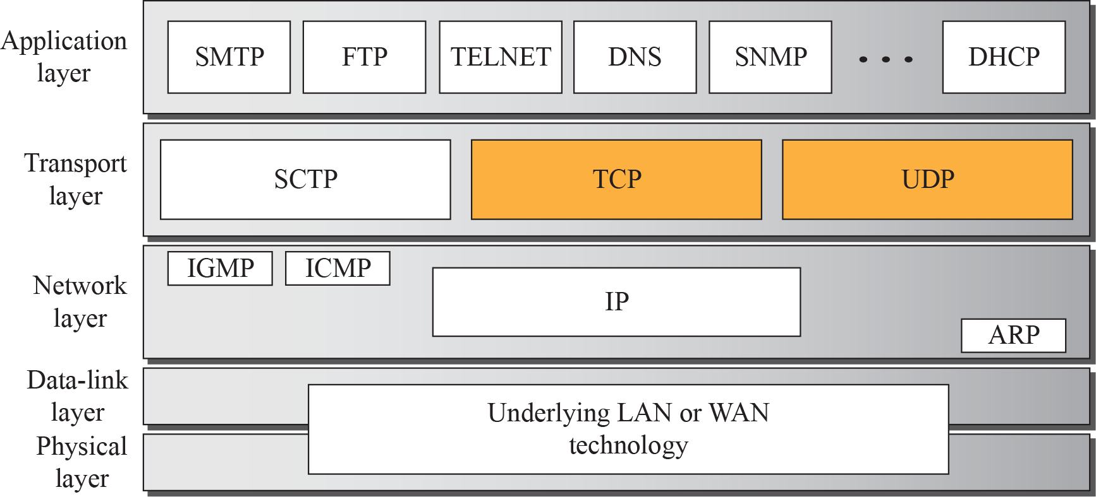
Position of transport-layer protocols in the TCP/IP protocol suite

Slide 4
Port Numbers
Port numbers(16 bit integers between 0 to 65,535) provide end-to-end addresses at the transport layer
IANA Ranges
Internet Assigned Number Authority had divided the port number into three ranges
Well Known Ports: ranging from 0 to 1023 that are assigned and controlled by IANA
Registered Ports: ranging from1024 to 49,151 that are not assigned or controlled by IANA. They can only be from regestered with IANA to prevent duplication.
Dynamic Ports: The ports ranging 49,152 to 65,535 are
neither controlled nor registered. They can be used by any
Process .

Slide 5
Socket Addresses( IP + Port number)
-Process to process delivery need two identifiers, IP address and port number at each end to make a connection .
A Transport Layer protocol needs a pair of Socket addresses(client,server).
IP address 200.23.56.8 port number 69
Socket address 200.23.56.8 60
The addressing mechanism allows multiplexing and demultiplexing by the transport layer

Slide 6
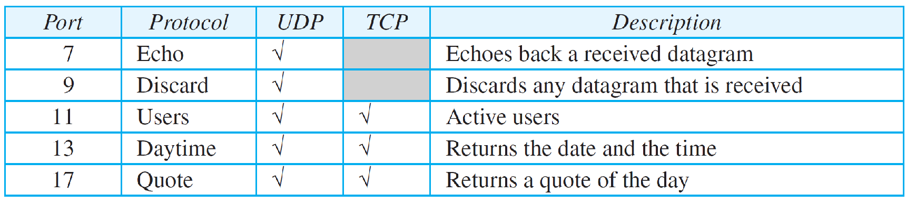
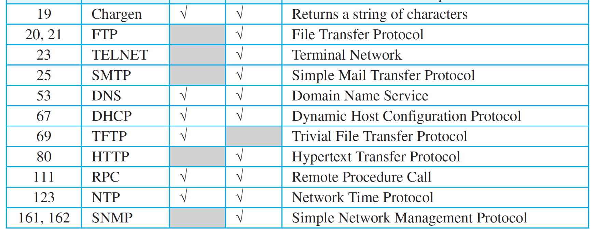
Some well-known ports used with UDP and TCP
from

Slide 7

UDP
The User Datagram Protocol (UDP) is
a connectionless, unreliable transport protocol
not much care about reliability, very limited error checking.
UDP is a very simple protocol using a minimum of overhead.
Is a convenient protocol for multimedia and multicasting applications.

Slide 8
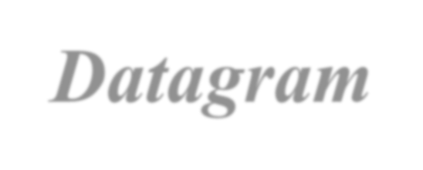

User Datagram
UDP packets, called user datagrams, have a fixed-size header of 8 bytes made of four fields, each of 2 bytes (16 bits)
Figure shows the format of a user datagram
The first two fields define the source and destination port numbers.
The third field defines the total length of the user datagram, header plus data
The last field can carry the checksum

Slide 9
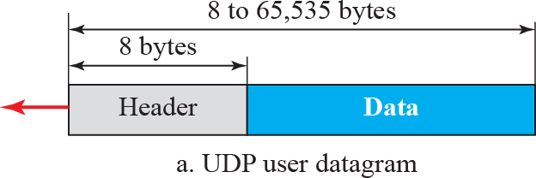
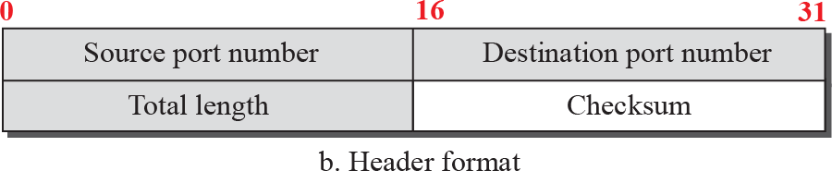
User datagram packet format

Slide 10
Example 24.1
The following is hexadecimal format.
the contents of a UDP header in
What is the source port number?
What is the destination port number?
What is the total length of the user datagram?
What is the length of the data?
Is the packet directed from a client to a server or vice versa?
What is the client process?

Slide 11
Example 24.1 (continued)
Solution
The source port number is the first four hexadecimal digits (CB84)₁₆ or 52100
The destination port number is the second four hexadecimal digits (000D)₁₆ or 13.
The third four hexadecimal digits (001C)₁₆ define the length of the whole UDP packet as 28 bytes.
The length of the data is the length of the whole packet minus the length of the header, or 28 − 8 = 20 bytes.
Since the destination port number is 13 (well-known port), the packet is from the client to the server.
The client process is the Daytime (see Table 3.1).

Slide 12

TCP
is a connection-oriented
reliable protocol
explicitly defines connection establishment, data transfer, and connection teardown phases

Slide 13




Sending process
Stream delivery
Receiving process
Stream of bytes

Slide 14
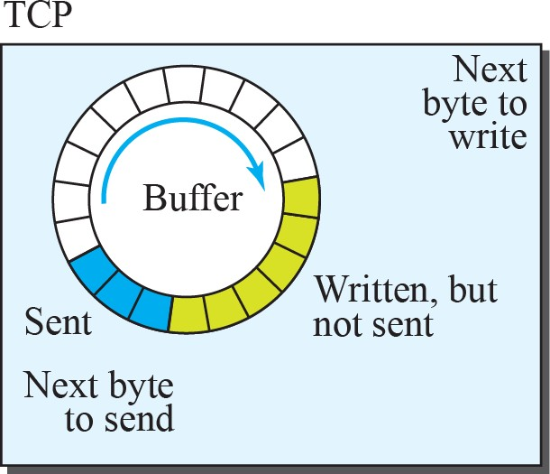
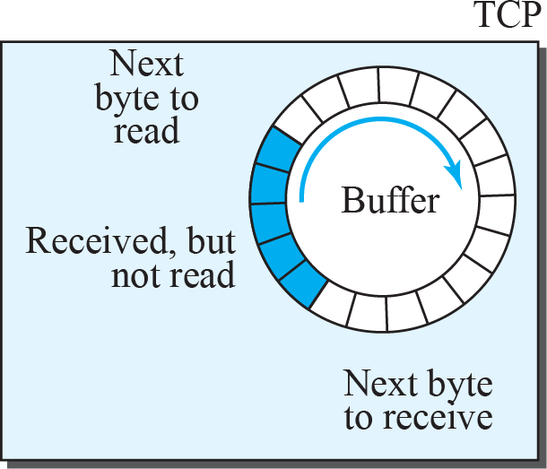
Sending and receiving buffers
Sending process
Receiving
process
Stream of bytes

Slide 15
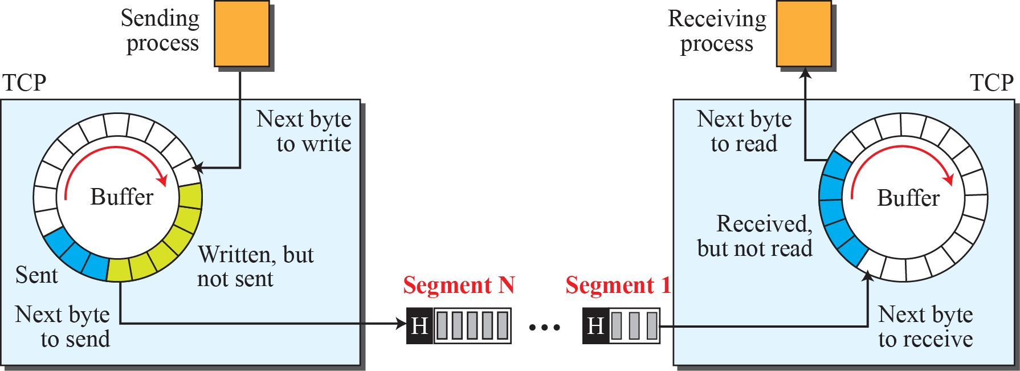
TCP segments

Slide 16
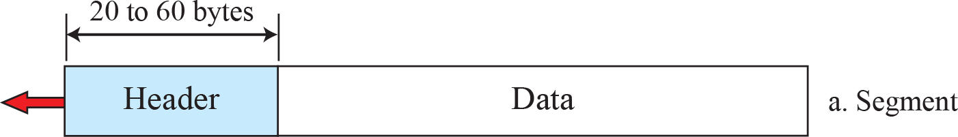
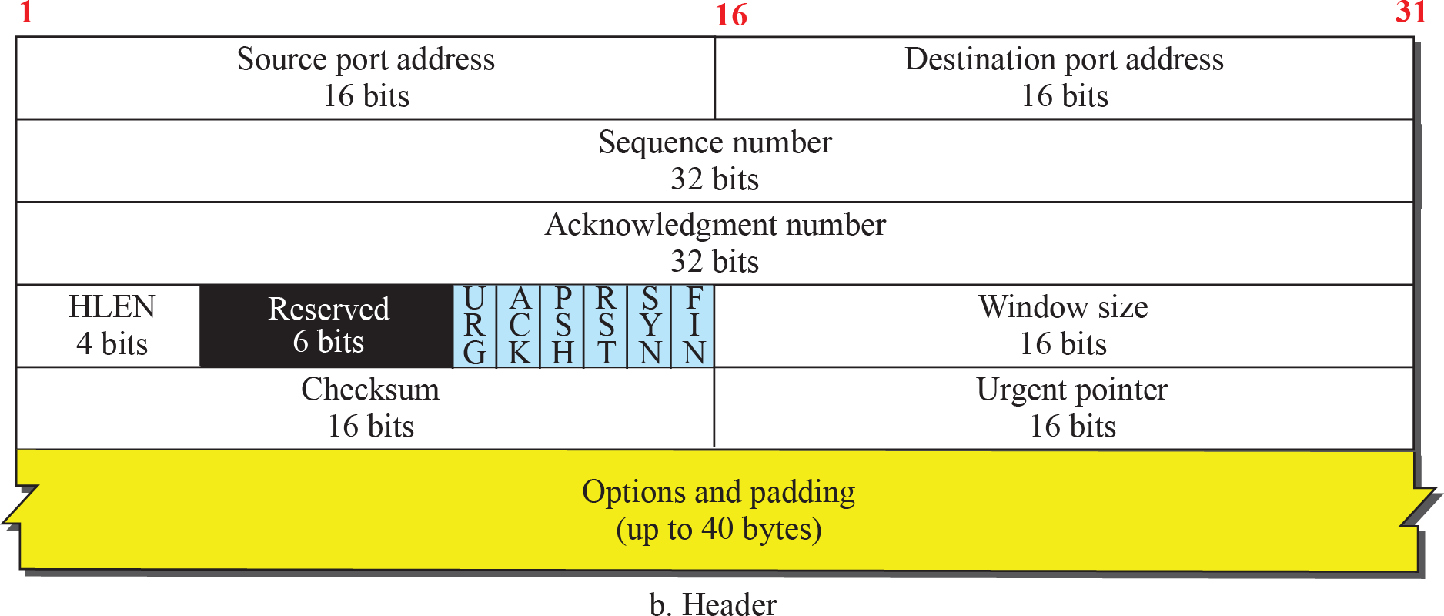
TCP segment format

Slide 17
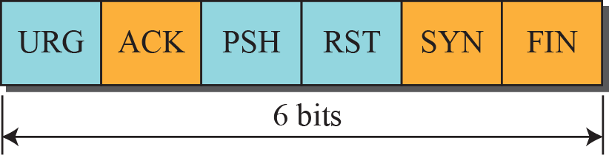
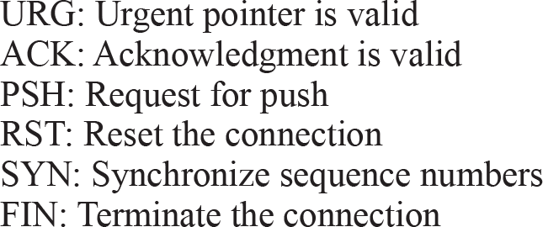
Control field

Slide 18
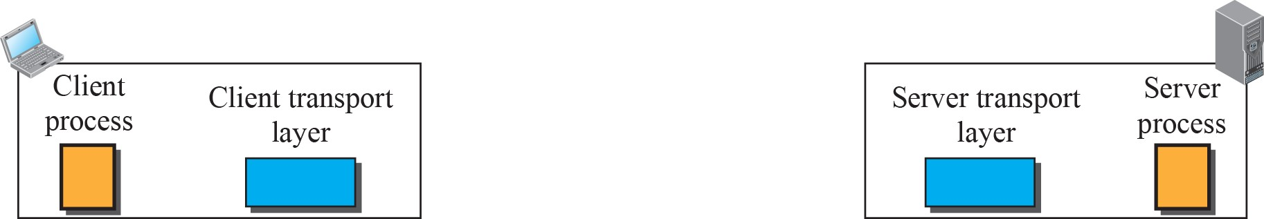
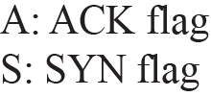
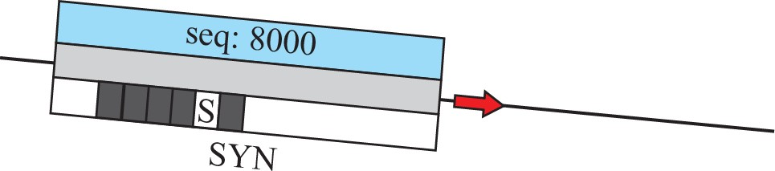


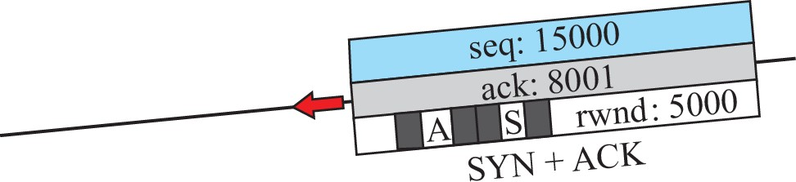
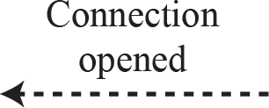
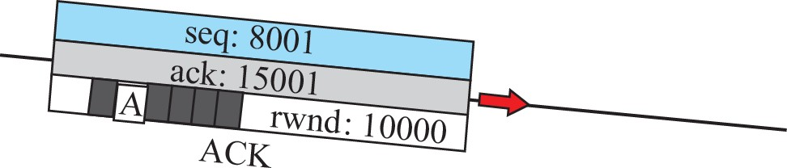
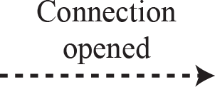
Connection establishment using three-way handshaking

Slide 19


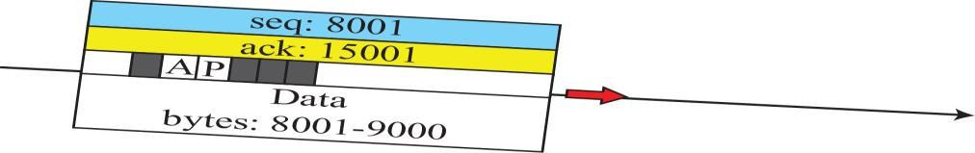

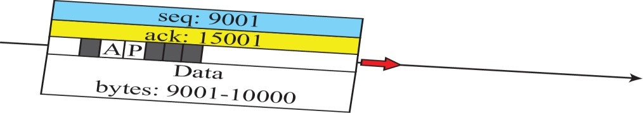
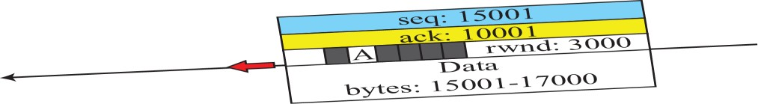


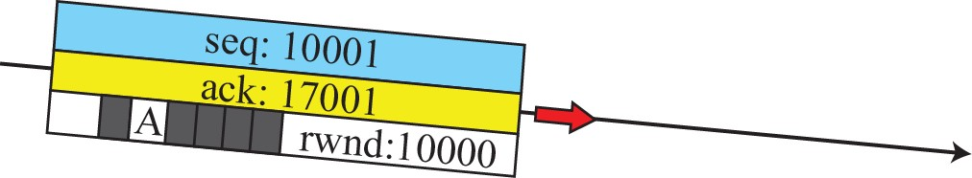

Data transfer

Slide 20
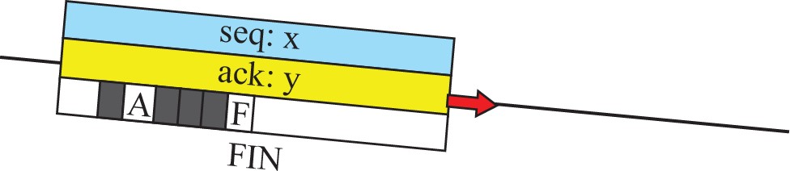

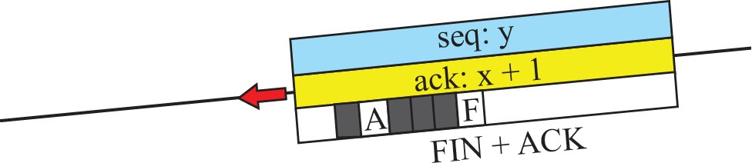
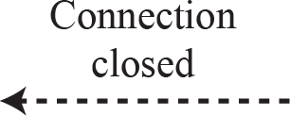

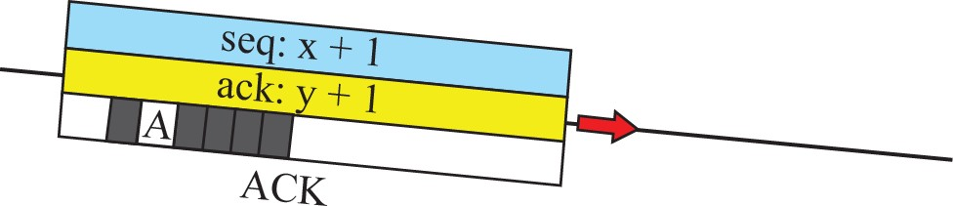
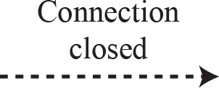
Connection termination using three-way handshaking

Slide 21
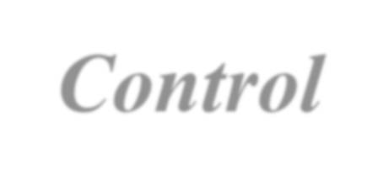

Flow Control
As discussed before, flow control balances the rate a producer creates data with the rate a consumer can use the data
We assume that the logical channel between the sending and receiving TCP is error-free.
TCP uses a sliding window protocol to accomplish flow control in which both hosts use a window for each connection .

Slide 22


Error Control
Error control in TCP is to ensure reliability in transport Layer protocol. The error control mechanisms in TCP detects,
1)Corrupted segments. 3)Out-of-order segments
2)Lost segments 4)Duplicated segments
TCP uses simple tools to detect the above errors,
1)Checksum
2)Acknowledgement
3)Time-out

